Slide 1
KALEYRA 2nd ROUND HACKATHON
Presentation on
the Problem Statement
“EXPENSES TRACKER”
By
Suman Pal -1NH17EC127
KALEYRA HACKATHON

Slide 2
Problem Statement-Expenses Tracker
Objective/Vision
To build an Expense Tracker application that can be used to track "Total Balance", "Income", and "Expenses “ in our daily life.
KALEYRA HACKATHON

Slide 3
Expenses Tracker
Introduction :-
The Expenses Tracker application shows, the balance, the income and the outcome.
it also has a dashboard where the user can add a new entry (an income or an expense).
User can can toggle between the income list (that show only all income entries) and the expenses list (that shows only the outcome entries) and all list that shows all the entries.
The user can edit or delete an entry. The web application has an interface, so the user can easily compare the income and outcome.
KALEYRA HACKATHON
26/05/2019

Slide 4
The application provides the following facilities to customers:
Facilitates of easy accessing from anywhere as this is a web application.
Customer can add their income and expenses on daily basis and can keep an eye on their expenses.
The application helps to show the Realtime updating of expenses when there will be any expenses or income of the particular customer.
Delete and add of expenses, both the features available in the application.
KALEYRA HACKATHON

Slide 5
How
Expenses Tracker helps?
Using the Expenses Tracker application, we can easily manage to maintain our daily life expenses.
KALEYRA HACKATHON

Slide 6
Software Requirements
Software Requirement
Web Technologies : HTML, CSS,JAVSCRIPT
KALEYRA HACKATHON
26/05/2019
Notes:
Deign Heuristics:
Sensible factoing
Good Cohesion
Minimal Coupling
Structure:
“implemented without difficulty,
tested without confusion, and
maintained without grief”

Slide 7
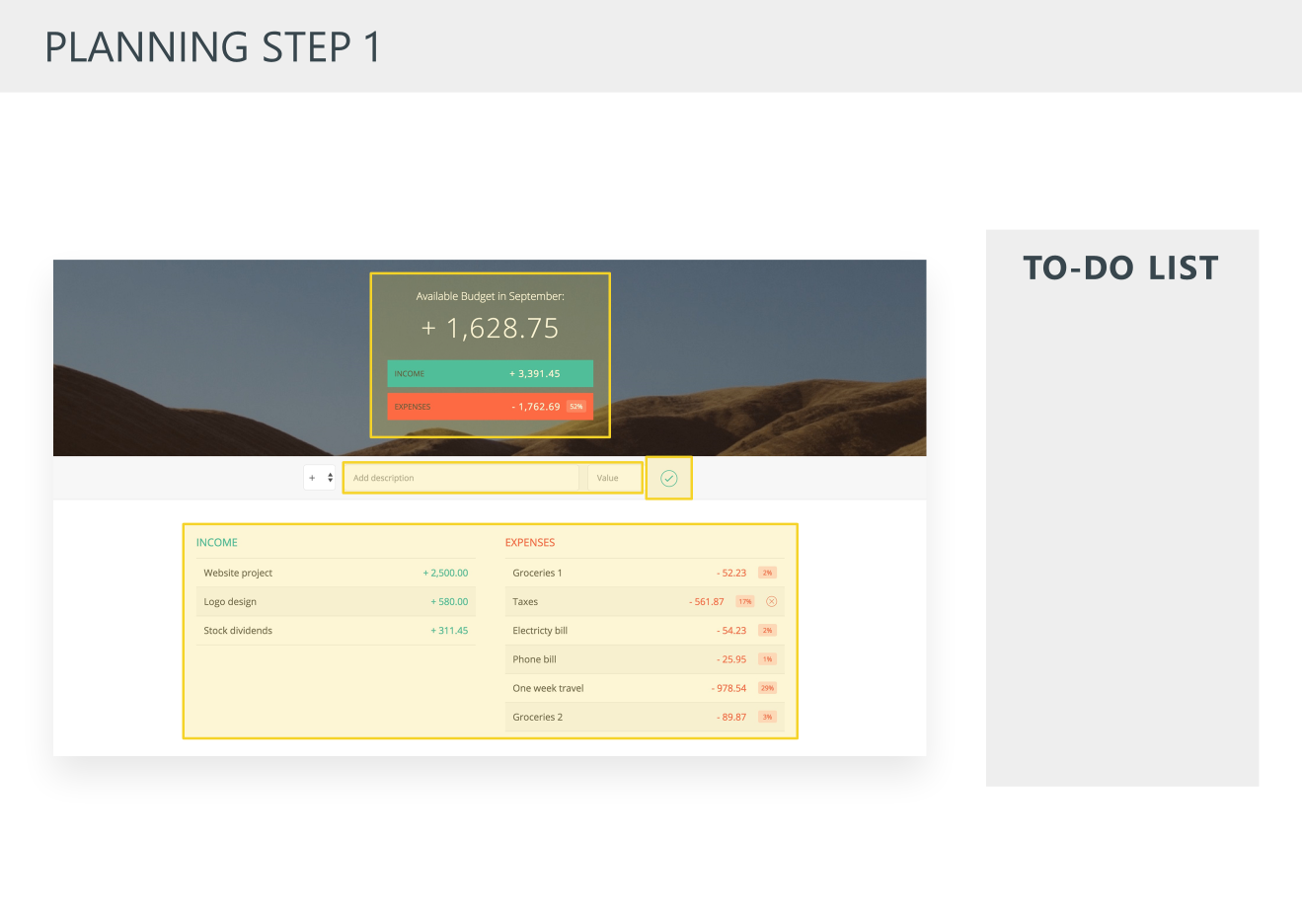
Planning Step1
KALEYRA HACKATHON

Slide 8
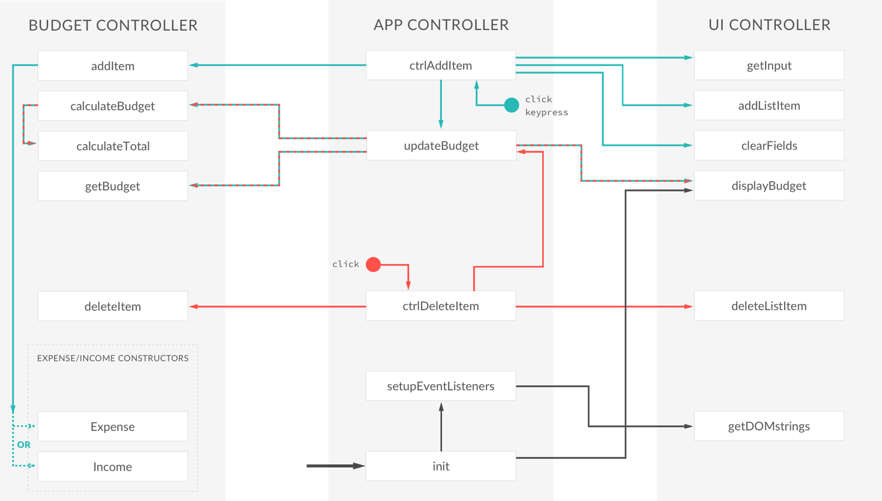
Architecture Step1
KALEYRA HACKATHON

Slide 9
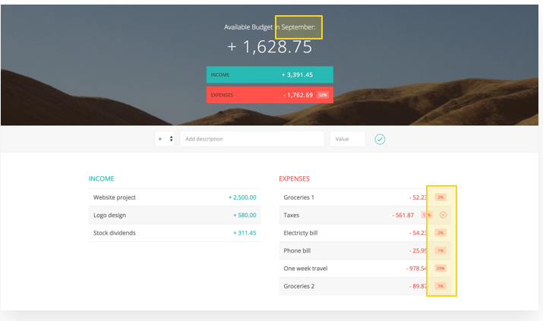
Planning Step2

Slide 10
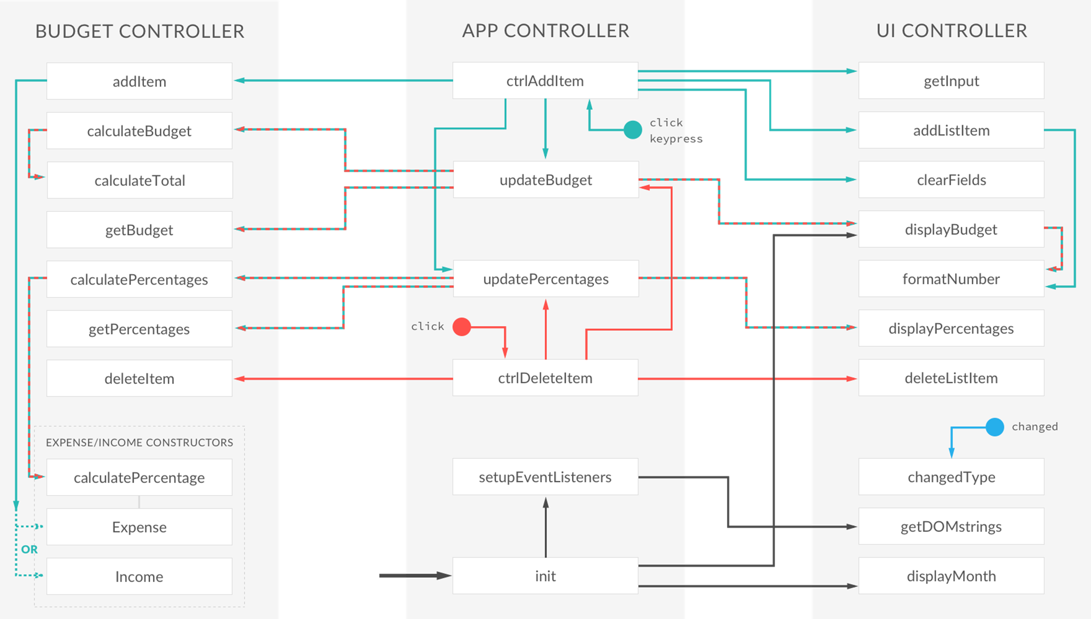
Complete Architectural Step2

Slide 11

User Interface
Expenses Tracker
KALEYRA HACKATHON

Slide 12
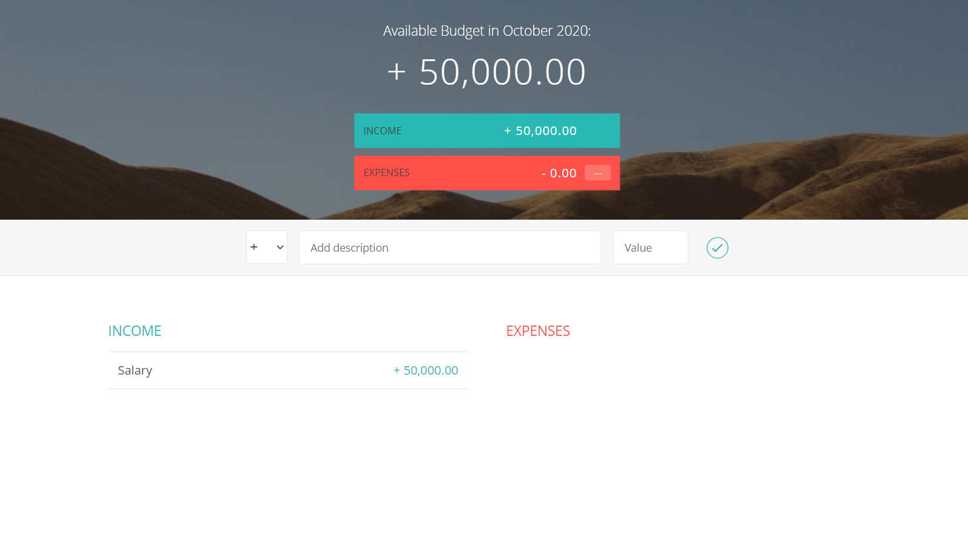
Adding Income
IIOT HACKATHON

Slide 13
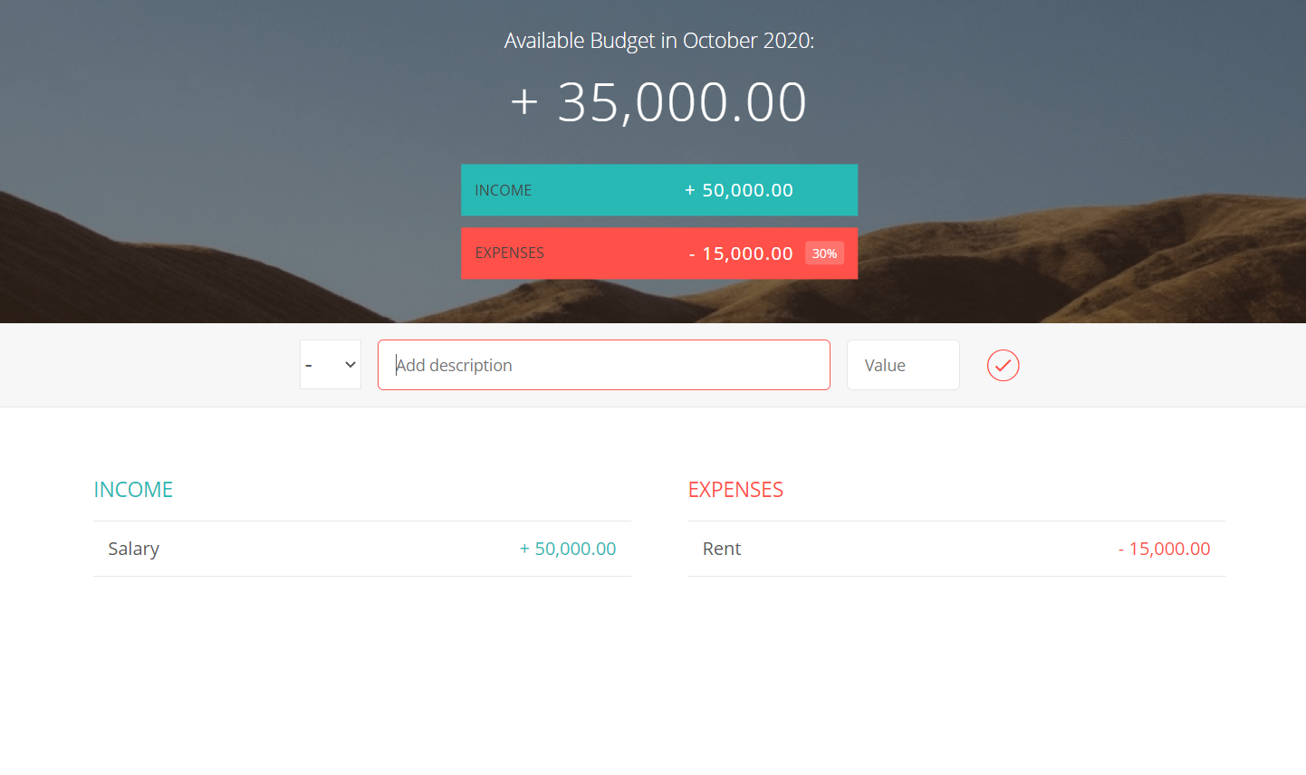
Adding Expenses

Slide 14
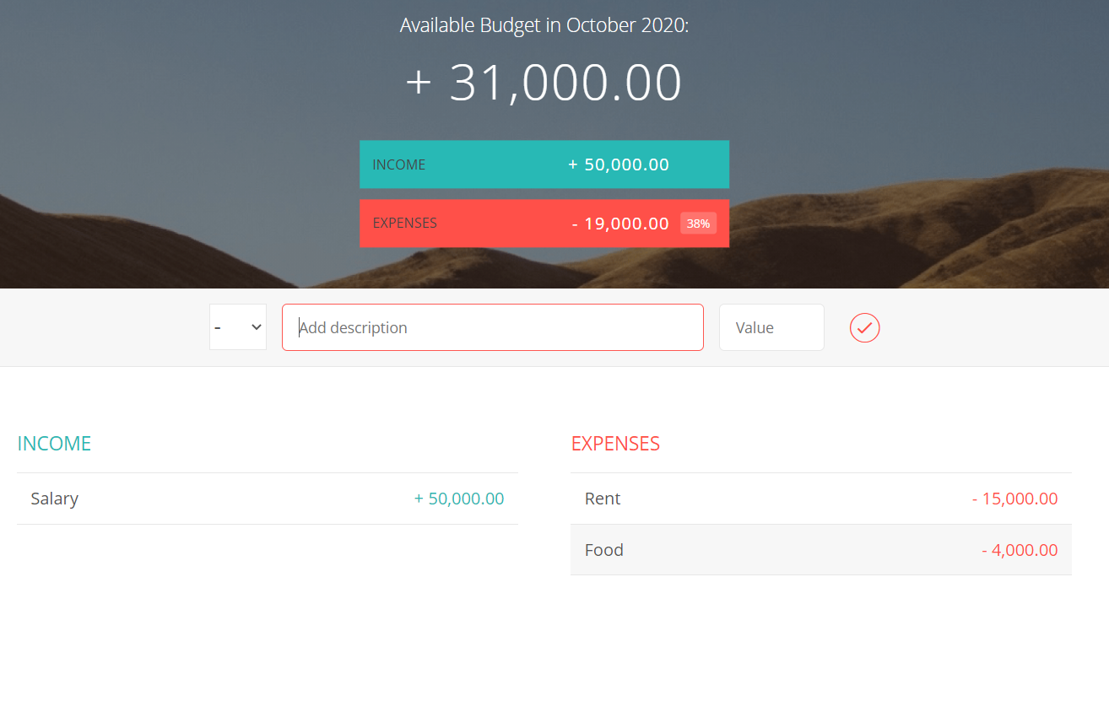
Shows Available Savings with Date

Slide 15
THANK YOU
KALEYRA HACKATHON

